Slide 1


The Vocabulary of Performance Tuning
SQL Saturday - Cleveland
John Deardurff
Website: ThatAwesomeTrainer.com
Twitter: @John_Deardurff
Email: John@Deardurff.com

Slide 2







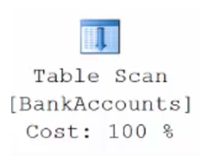

The Vocabulary of Performance Tuning
Query Processing
Transactions
How Data is Stored
Tables Structures
Execution Plans

Slide 3

Batches vs Transactions
Batches
Transactions
VS
TSQL2012.mdf
Sends Code to the Processor
Modifies Data in the Database

Slide 4
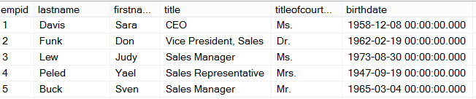
Ad Hoc Query
First Time
Stored Procedure
Syntax
Parse
Execution Context
Resolve
Compile
Optimize
Execution Plan
Procedure Cache
Compile
Compile
Run Time
Execute
Execute
Execute
Execute
SQL
SQL
Sets
Sets

Slide 5
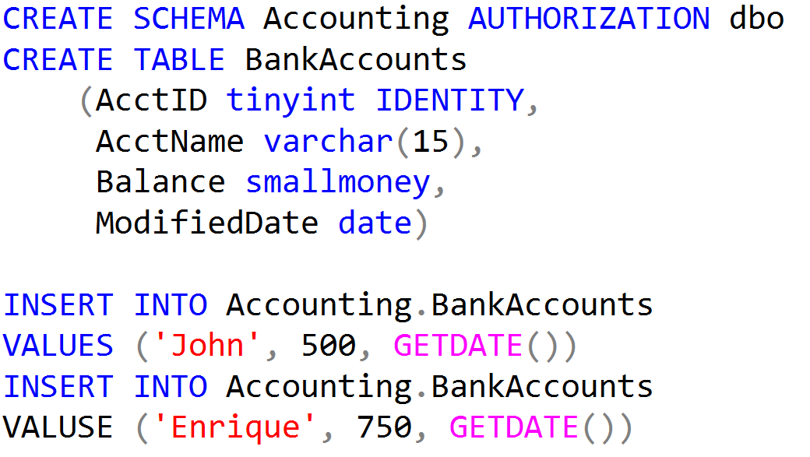
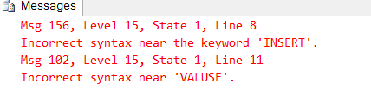
Working with Batches

Slide 6
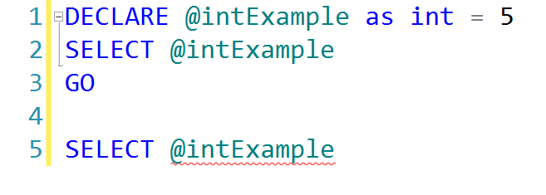
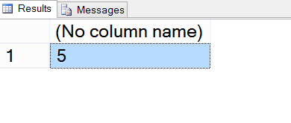
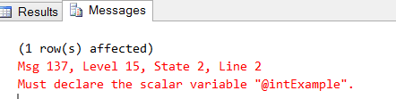
Batches and Variables
First Batch Successful
Second Batch Fails

Slide 7
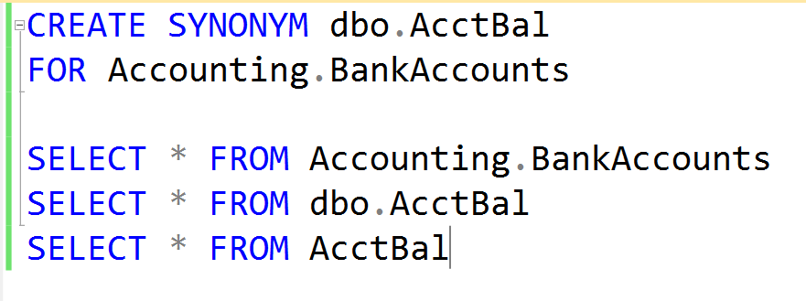
Creating Synonyms

Slide 8
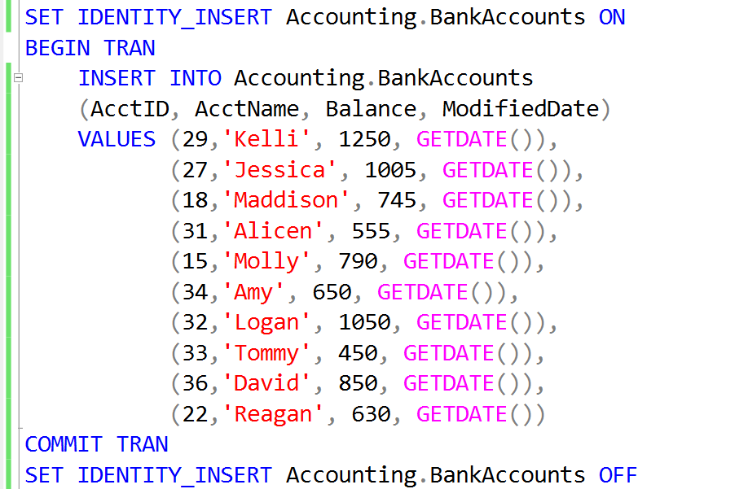
Inserting Records into an IDENTITY field

Slide 9
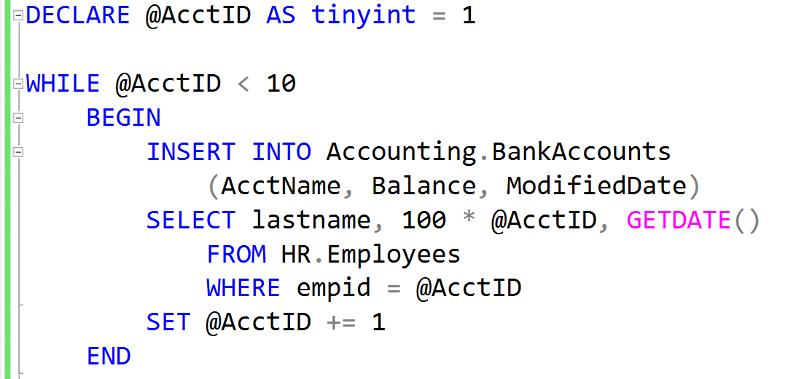
Adding Records using a WHILE loop

Slide 10
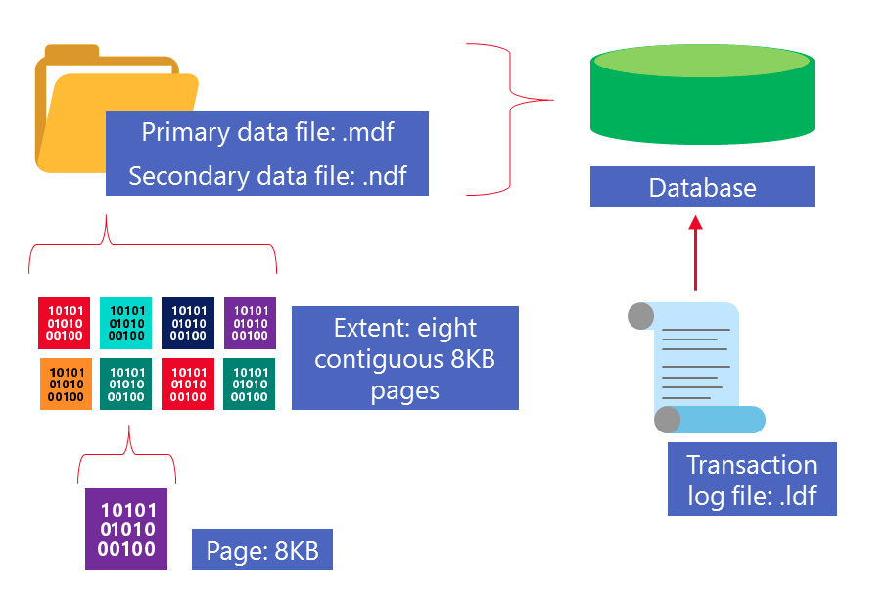
How Data Is Stored in SQL Server
Notes:
Provide an overview of how the data is stored on SQL Server. Describe each of the three data file types and the basic internal layout of the data files. Stress that the file extension .mdf is not mandatory to use but is highly recommended.
Describe the difference between uniform and mixed extents. Note that continued support for mixed extents adds complexity to the database engine for no real benefit. The size of an extent (64 KB) is so small that the original benefit from the mixed extent design is now irrelevant.
Briefly explain that all transactions are written to the log file using the WAL mechanism to ensure the integrity of the database in case of a failure and to support rollbacks of transactions. Explain that data changes occur in the buffer pool and are not written immediately to the data files.
Avoid discussing filegroups at this point, as they will be covered later.
20462C
3: Working with Databases and Storage

Slide 11
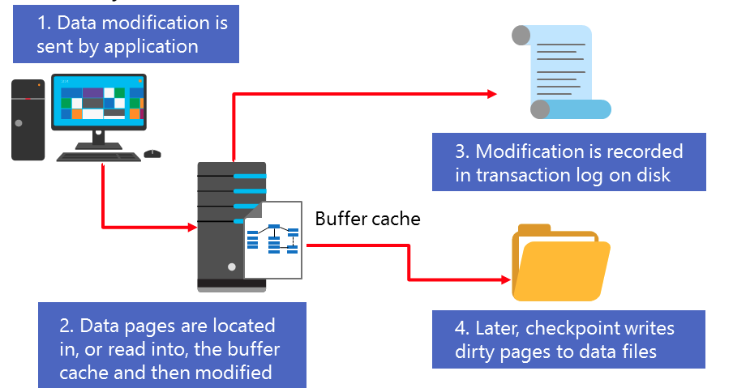
Data Modification

Slide 12
Rows stored in Data Pages
Page Header
(96 bytes)
Header contains Page Information such a Page Number and Page Type
Data Row 1
Data Row 2
Data Row 3
8000 bytes for Data Rows or Free Space
Free Space
Row Offest Array
Displays how far from beginning of page each row is located.

Slide 13
How Data is Stored in Data Pages
Heap
Data stored in a Heap is not stored in any order and normally does not have a Primary Key.
Data Row 8
Data Row 2
Data Row 7
Data Row 6
Data Row 5
Data Row 4
Data Row 1
Data Row 3
Data Row 9
Clustered Index
Clustered Index data is stored in sorted order by the Clustering key. In many cases, this is the same value as the Primary Key.
Data Row 1
Data Row 4
Data Row 7
Data Row 2
Data Row 5
Data Row 8
Data Row 3
Data Row 6
Data Row 9

Slide 14
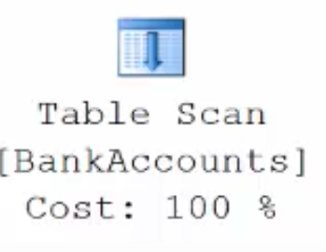
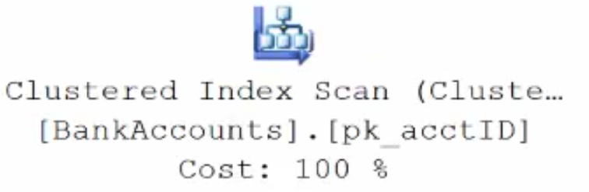
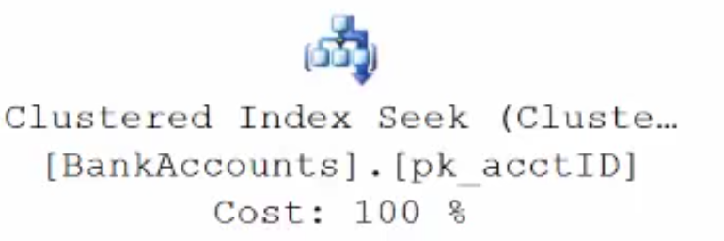
Execution Plans
Data stored in a Heap is not stored in any order and normally does not have a Primary Key.
Clustered Index data is stored in sorted order by the Clustering key. In many cases, this is the same value as the Primary Key.
Using a WHERE statement on an Index could possibly have the Execution Plan seek the Index instead of scan.

Slide 15
WHERE State = ‘IN’
ROOT
AZ -IN
IA - ND
OH - WA
CA 2
GA 8
FL 4
FL 16
IL 10
IN 1
IN 3
IN 7
IN 9
IN 12
IN 13
NV 5
MT 19
KS 14
TN 18
TX 6
VA 17
WA 11
WA 15
WA 20
Non–Clustered Index
Clustered Index
Or Heap
ROOT
1 - 7
8 - 15
16 -20
1 John IN
2 Armando CA
3. Enrique IN
4. Heather FL
5 Sharon NV
6 Rachel TX
7 Hope IN
8 Ed GA
9 Breanna IN
10 Gary IL
11 Veronica WA
12 Jessica IN
13 Kelli IN
14 Bob KS
15 Morgan WA
16 Elias FL
17 Sidney VA
18 Tamera TN
19 Leann MT
20 Kori WA

Slide 16
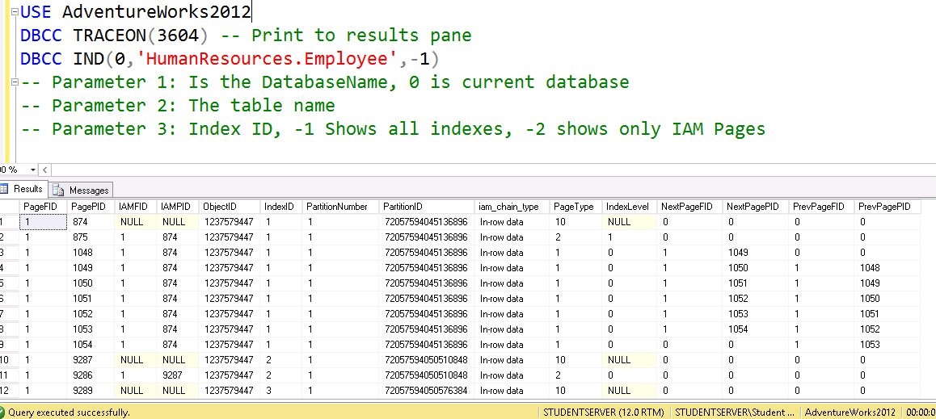
DBCC IND

Slide 17
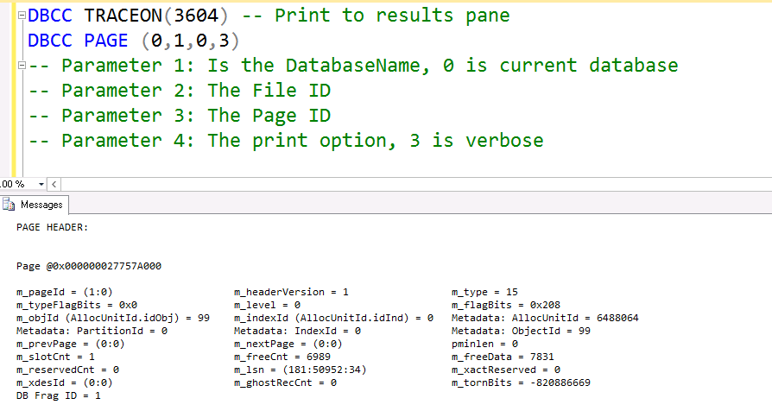
DBCC PAGE

Slide 18
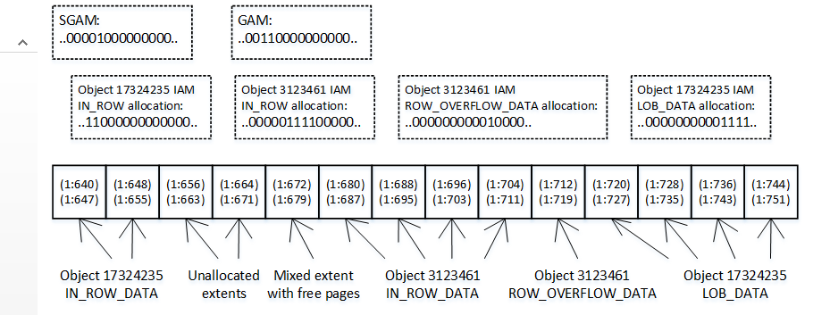
Index Allocation Map Pages
Each Allocation Unit has at least one IAM Page
Shows Uniform Extents and Mixed Extents
IAM is an 8000 byte map or 64000 bits which covers 4GB of extents in a file. (GAM Interval)

Slide 19
Transactions must pass the ACID test
Atomicity – All or Nothing
Consistent – Only valid data
Isolated – No interference
Durable – Data is recoverable

Slide 20
Transaction Log Recovery
Transaction Recovery
Action Required
1
None
2
Roll forward
3
Roll back
4
Roll forward
5
Roll back
Checkpoint
System Failure

Slide 21
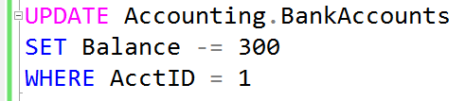


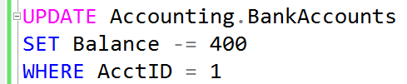
What is a Lock?
Transaction 1
Transaction 2
TSQL2012.mdf

Slide 22
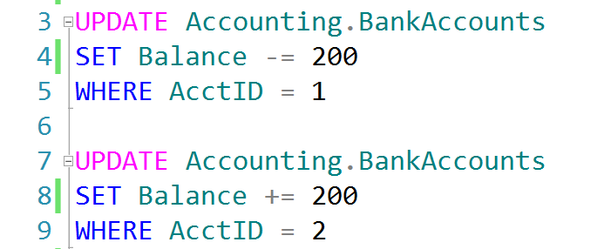
Auto-Commit Transactions without Error Handling
TSQL2012.ldf
Checkpoint
TSQL2012.mdf
John, don’t forget to demonstrate
SET XACT_ABORT ON

Slide 23
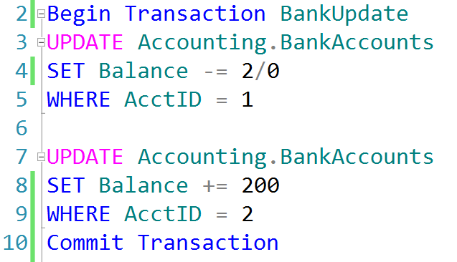
Explicit Transactions without Error Handling
TSQL2012.ldf
Checkpoint
TSQL2012.mdf

Slide 24
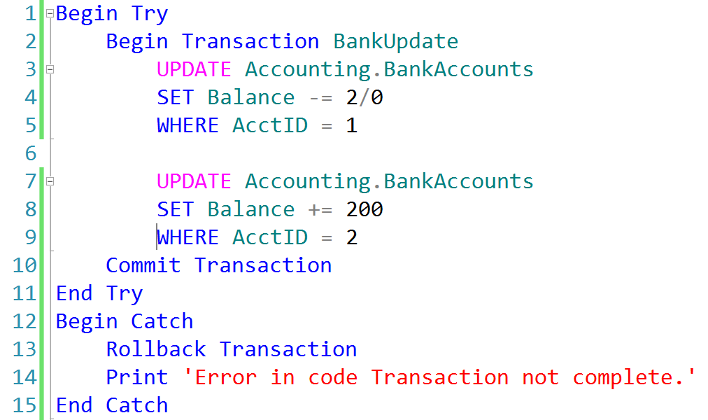
Explicit Transactions with Error Handling
TSQL2012.ldf
TSQL2012.mdf
Checkpoint

Slide 25
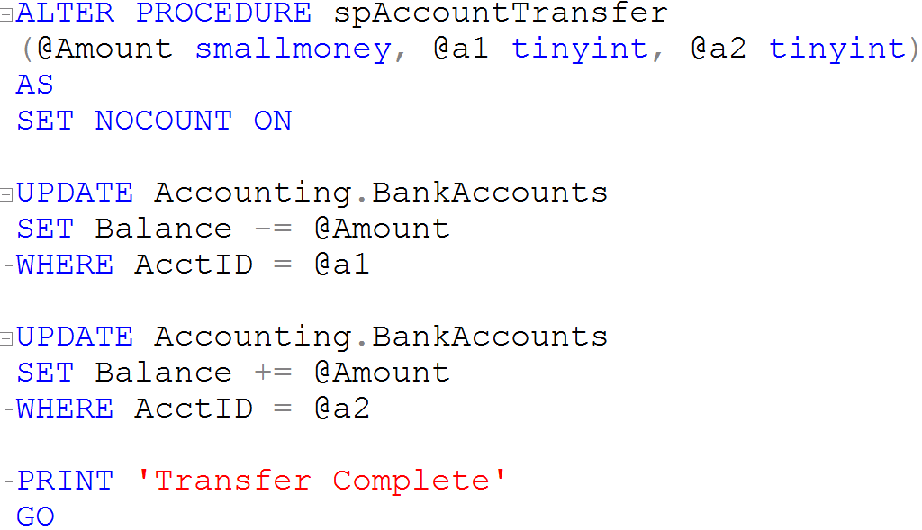
Creating Stored Procedures

